Slide 1
Linking Pedagogical Practices of
Activity-Based Teaching and Learning Assessment Strategies
CYC-NET Clan Gathering
Paisley, Scotland
March 21, 2012
Presenter:
Jenny R McGrath, MS
Grant MacEwan University

Slide 2
During my brief presentation I will
Provide a brief overview of some of the central tenets of activity-based education
Illustrate how activity-based education is practiced in Child and Youth Care (CYC) education
Showcase activity-based education pedagogy in the student learning assessment process

Slide 3
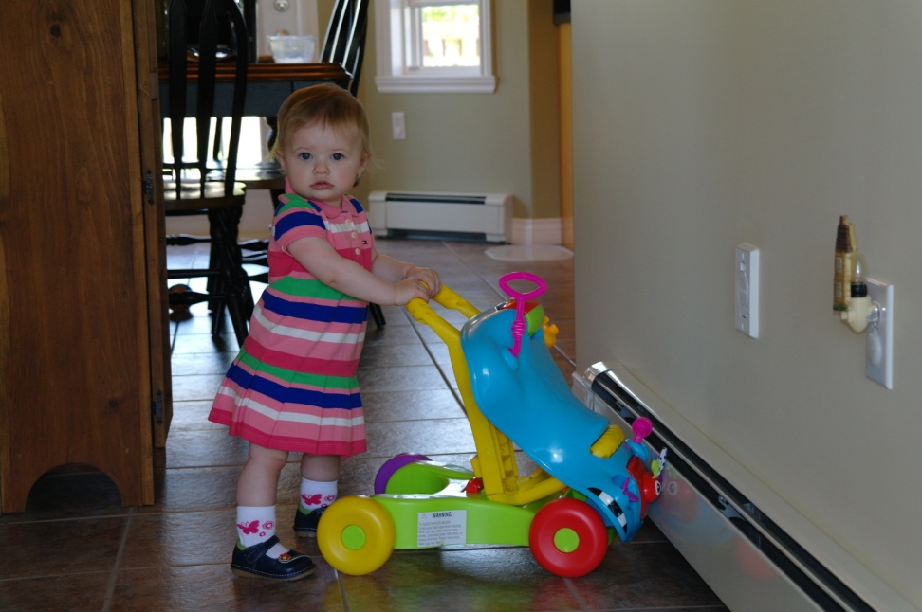
My early love affair with activity
Girl Guides of Canada
Music
Sports
Student Leadership
Travel
Success through non-traditional classrooms
Camping
Relationships with family and friends

Slide 4

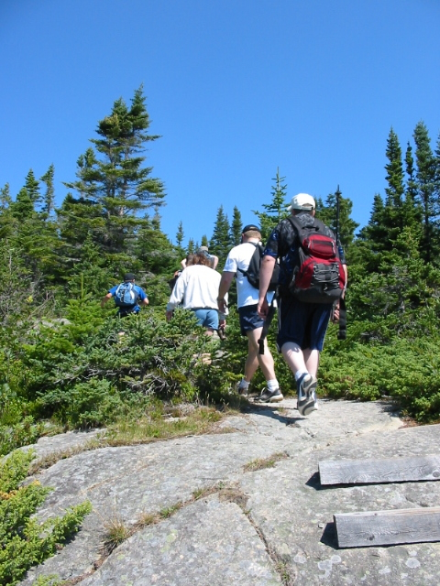
It’s not just an ice-cream
Activity is an essential intervention strategy in CYC because it promotes:
  Relationship building
  Trust
  Autonomy
  Communication
  Self-efficacy
  Confidence
  Social skills
  Self control

Slide 5
What is activity-based education?
Student is more actively involved in the learning process
Emphasis is on the experiential
“Heads on” as well as “Hands on”
Congruent with relational epistemology
Being
Critically Reflecting
Doing

Slide 6
Goals of activity-based education
Focus on student learning
Activity is personally significant or meaningful to the student
Creates a high level of personal engagement
Students are given opportunity to write about, discuss and/or reflect on the process
Encourages critical thinking, problem solving, communication and collaboration
Allows some degree of student voice and choice

Slide 7
Examples of
Activity-Based Education
Used across all four years of the bachelor of child and youth care
Grant Macewan University

Slide 8
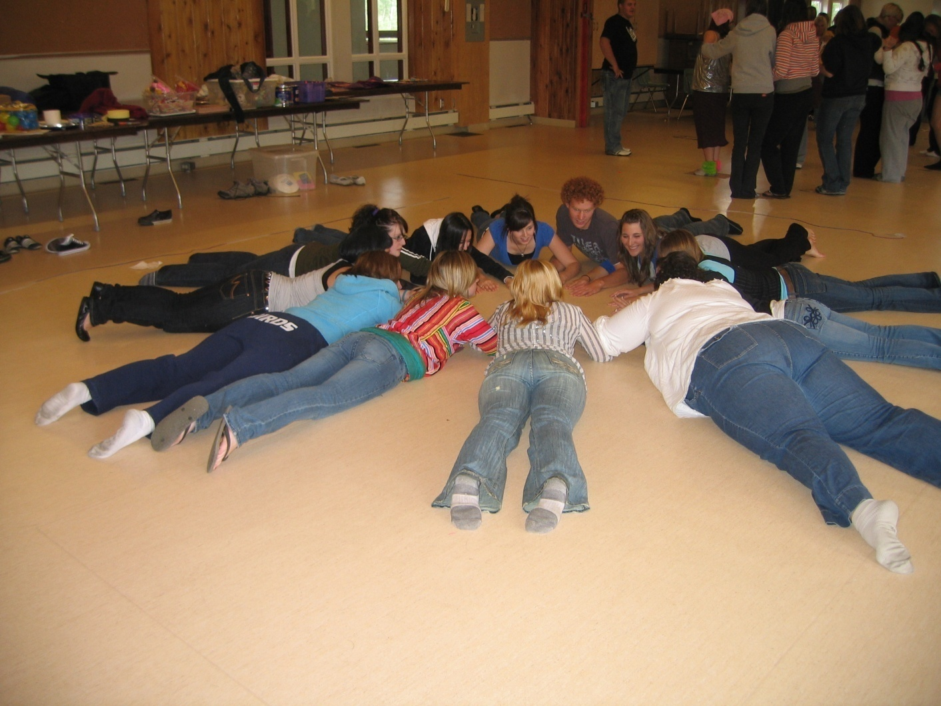
Students and faculty engaged in activity at an annual student retreat
“The idea of spending two days and a night with a group of people I had never met was terrifying. I never imagined I would leave with 35 friendships – a handful of them who would turn out to be lifelong friends”
~ first year student

Slide 9
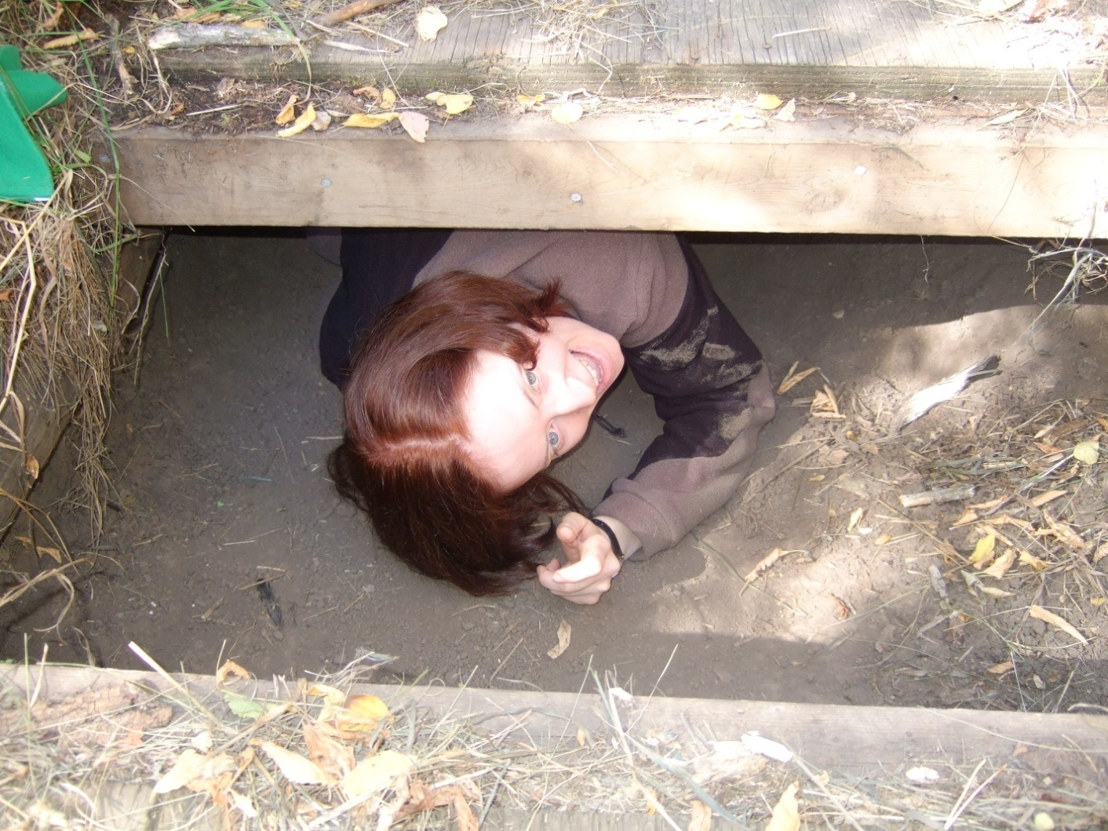
Making my way through an underground tunnel during a challenge trail with my activity programming class
“I was still not 100% comfortable with my classmates. I jumped into the tunnel because I did not want to look weak in front of my new peers. That went out the window when half way through, I panicked. Two strangers talked me through the tunnel and stuck with me the whole time. Once I reached the other side, everyone cheered! That experience showed how supportive my peers are”
~ first year student

Slide 10
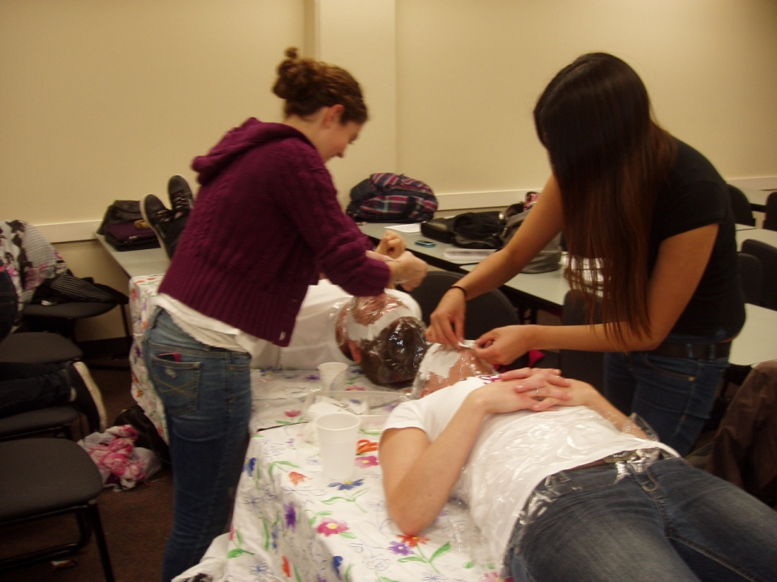
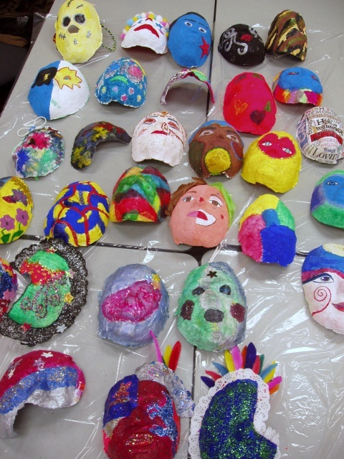
Students are instructed to decorate the inside of the mask to represent their self care plan and the outside to represent their professional identity
Completed Masks
“This project has continued to teach me things about myself and my practice. It has become an excellent reference point of my growth personally and professionally”
~ first year student
Students applying plaster
to their partners face

Slide 11
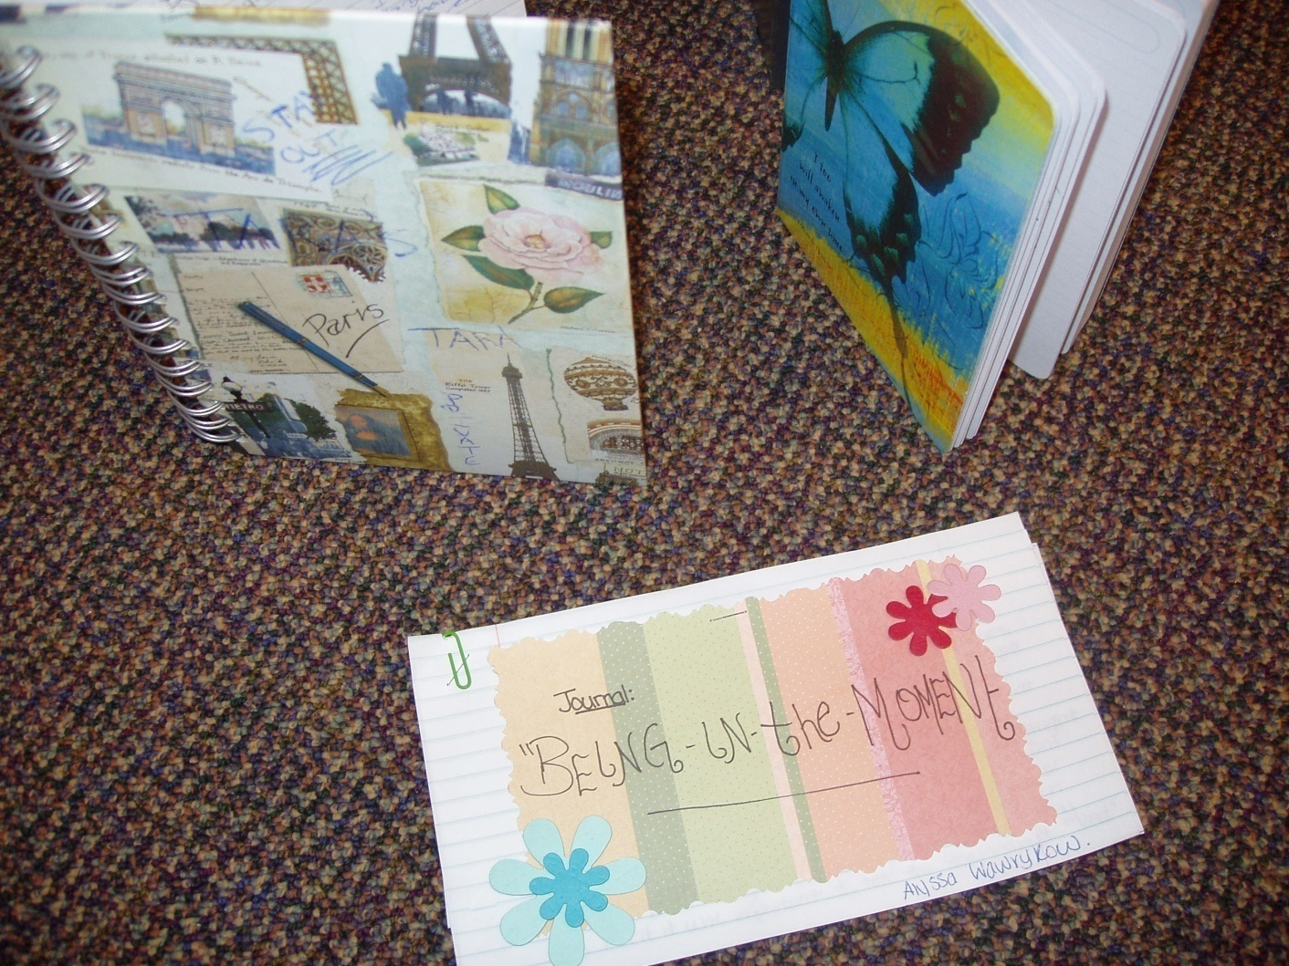
Illustrating personal praxis
One student used the analogy of dance, specifically through a variety of well worn dance shoes to illustrate her idea of praxis. She discussed how she was awkward and out of step in the beginning but as she received more training, practice and support, she was better able to complete intricate steps and was eventually able to design her own choreography and teach others how to dance

Slide 12
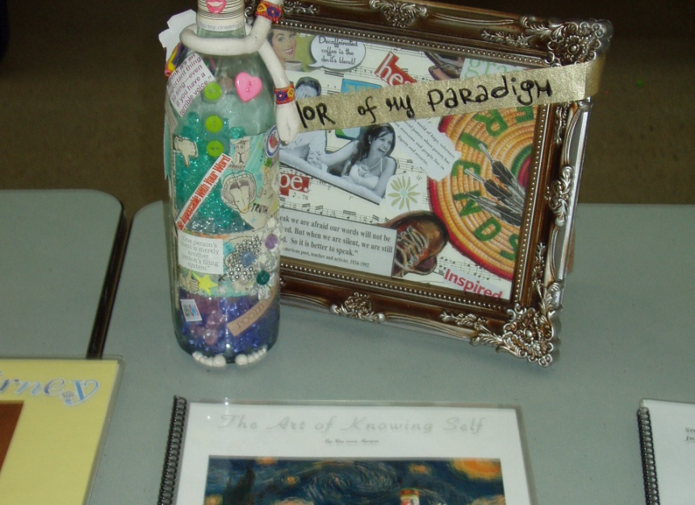
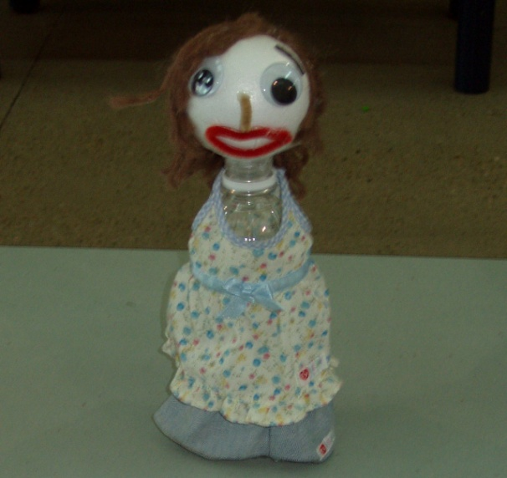
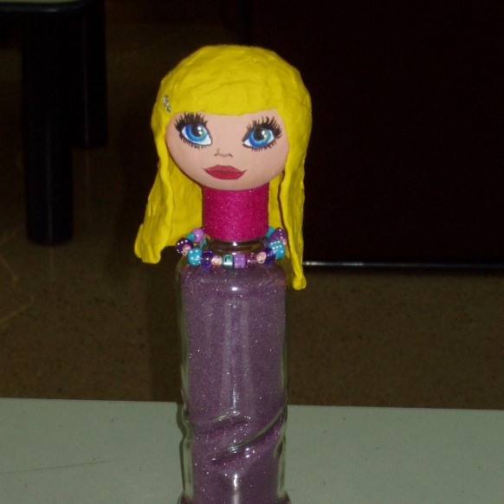
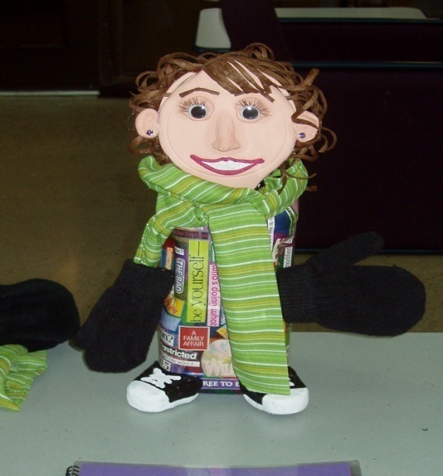
Bottle Assignment
In a 3rd year course on theoretical frameworks and practice methods, students select a bottle of their choice and create an image of themselves onto the bottle. They are then required to take an electronic photo of their bottle against a backdrop that they create to illustrate their interpretation and personal experience of the course content

Slide 13
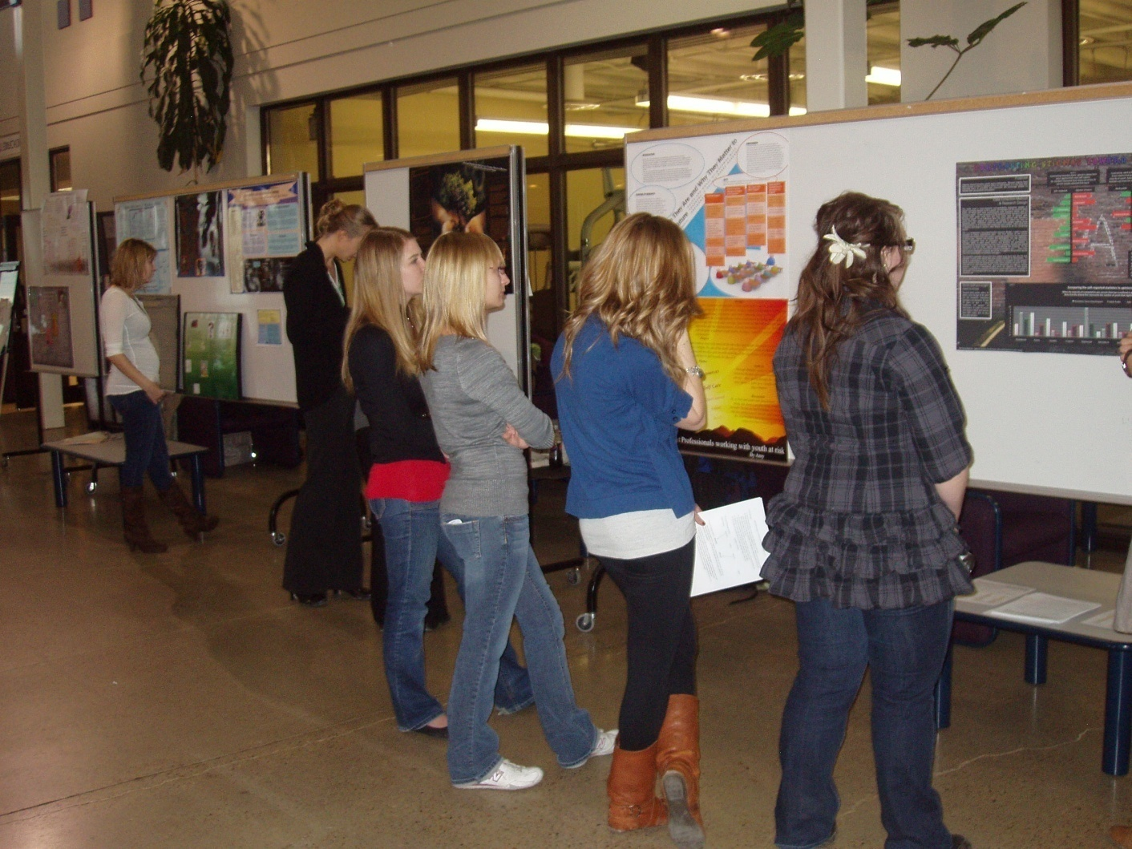
Course based research project
4th year
Students learn:
How to read
How to critique
How to use
How to do research
The showcase promotes:
Curiosity
Confidence
Critical thinking
Creativity

Slide 14
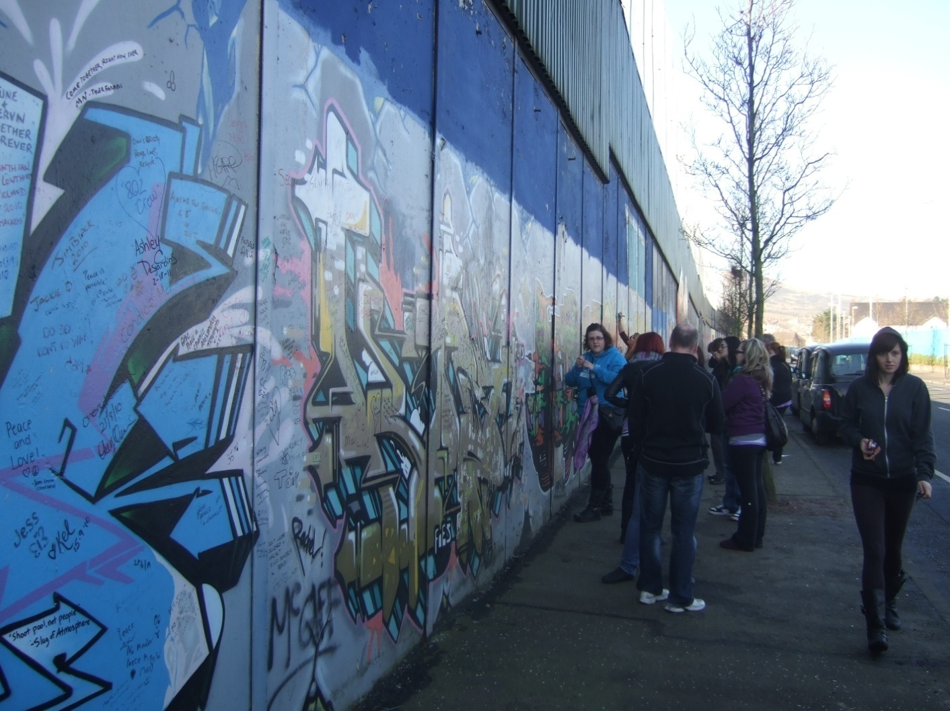
Signing the peace wall in Belfast, Ireland
During a short term study abroad field course students:
Attend classes
Interact with Irish students
Visit CYC agencies
Learn about Irish history
Experience cultural tours
Journal about their trip
Complete presentations in Ireland and in Canada

Slide 15
Examples of activity-based assessment
Assessment | Benefits
Portfolio | Creative; reflective; collection of student work
Case Studies | Simulates real life scenarios; critical thinking; reflection
Group Work | Collaboration; divergent thinking; presentations
Projects (such as masks) | Personal; meaningful; creativity; practical application
Research | Investigation; engage with methodologies
Showcases | Confidence; dissemination of work; engaging
Discussion boards | Engaging, especially for quieter students; allows for more depth to discussions

Slide 16
Why do it?
The benefits are endless for instructors and students: engagement; relationship; challenge; diversity; memories; creativity; fun; learning
Moves focus from teaching to learning
Assesses not only content but also application, integration and reflection
Examples of activity are always talked about with humour and pride at graduation and other significant events
Thank-you!!!
“Tell me and I forget. Show me and I remember. Involve me and I understand.
~ Chinese Proverb

