Slide 1
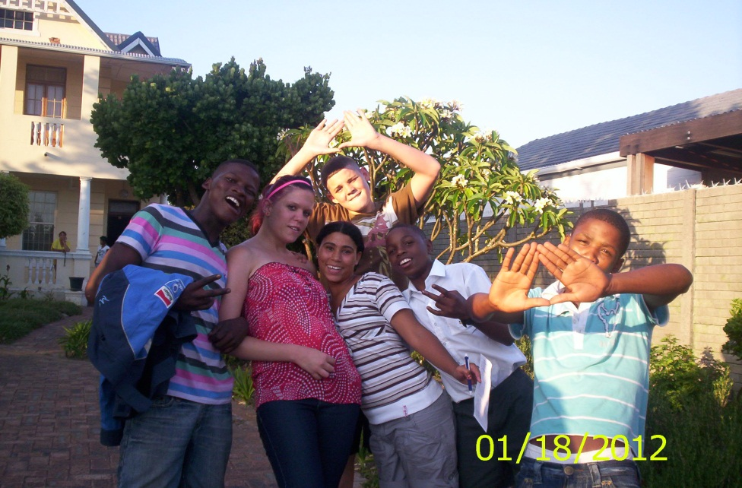
A journey towards independent living
A Girls and Boys Town Research Initiative with Prof. Adrian Van Breda: University of Johannesburg
PRESENTER: LEE LOYNES
CEO Girls and Boys Town SA

Slide 2
Formulating ‘Success’
How to conceptualise and formulate the mission for research
Success indicators: steady income, no crime, stable relationships, job prospects, independence = ‘success’
Success narratives: listening to the stories of resilience in the face of adversity and learning to appreciate strengths and capacities = ‘successing’

Slide 3
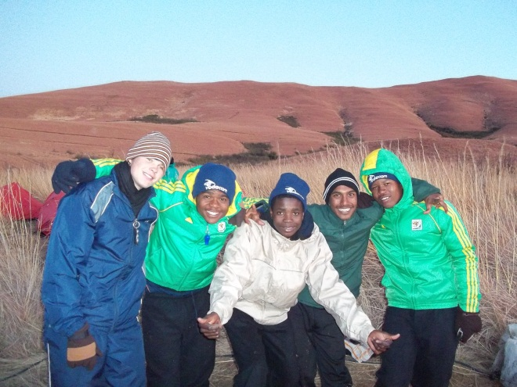
STUDY SAMPLE
9 young people.
All male.
Between the ages of 20-23.
Diverse racial backgrounds.
Diverse living environments.
Academic background (grade 9-university)

Slide 4
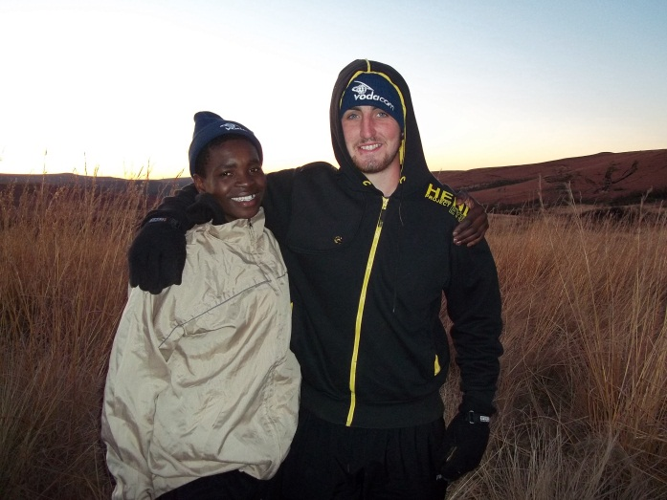
the journey: A Nascent theory
The Struggle:
External – Escaping the quicksand of the past
Internal – Own conflicting desires
The Hope:
Emerging social processes – to create a better FUTURE and SELF
The Challenge within the Hope:
The heaviness of grey necessity
The Archetypal Hero:
Standing apart
The developing skilled warrior

Slide 5
Struggle toward independence
Holding down his job for three years: “Basically, what I feel good about in my life, everything. But what I'm most proud of is my job that I've got now, my job that I've got now. To keep a job, for me it’s very hard to keep a job” [#287].
Securing accommodation is a significant goal, as he still lives with his father and step-mother, which is a profoundly abusive social environment for him. “My own place, nobody else is moving in again. I've learnt my lesson” [#46]. “I've made my mind up that I'm going to go on my own and my target is to make it while I am on my own, and I believe I'm going to make it” [#48].

Slide 6
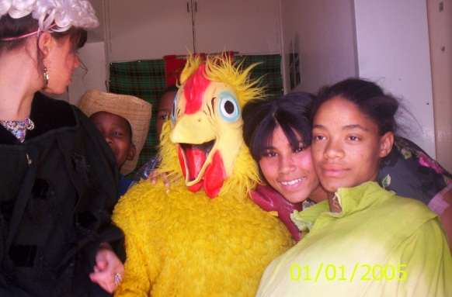
Theme 1
Contextualised Observation, Learning and Action
Definition:
Having a sharp eye, that is attentive to context.
The ability to assess social situations

Slide 7
Illustrative narrative
“At the end of the day he wanted me to work for him, and I knew that’s the time I had to get myself out, so I disappeared”[#136]. “And all that sounded nice [car, money, rings, clothes] but I knew at the end of the day what’s going to happen, because I saw how he treated his people. I saw how they got beaten up.....gun pointed and all that” [#140].

Slide 8
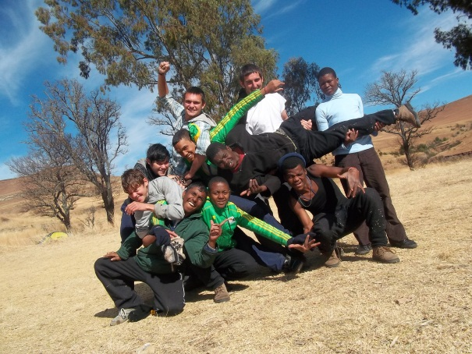
Theme 2:
Networking People for Goal Attainment
Definition
A capacity to establish networks of people to adopt supportive roles.

Slide 9
Illustrative narrative
“And he’s like, ‘Listen here, you are not supposed to be on this property’, and it’s a black guy – a very nice black guy and he speaks a very beautiful Afrikaans. He told me listen here, you look like a very smart white kid, I'm going to let you stay here provided you help me take care of this house and see that nothing goes with it, no vandalisation or whatsoever goes on here. Now I'm like, okay no it’s cool. Then I started staying there” [#18].

Slide 10
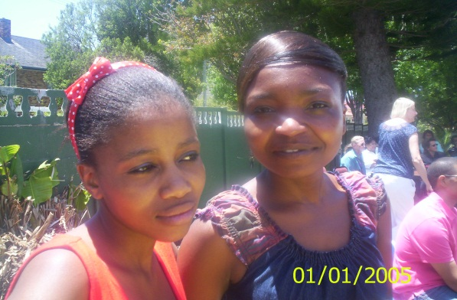
Theme 3:
Seeking Mutually Satisfying Relationships
Definition:
A yearning to belong. To be part of a mutual, reciprocal, familial/intimate relationship.

Slide 11
Illustrative narrative
“I've had a very bad experience with women regarding with chatting them up, saying the wrong thing at the wrong time without me noticing that I mess everything up, then I have to get it back up to standard where it was and that’s a big challenge” [#240]. “Every time when I meet someone new I always find a way without me noticing to mess it up. I always, always. But I keep on telling him that’s my bad luck” [#251].

Slide 12
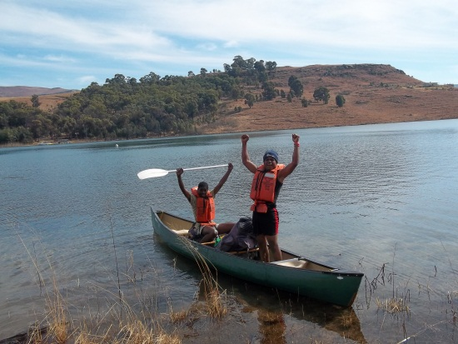
Theme 4:
Building Hopeful and Tenacious Self-Confidence
Definition:
Hope: That things will get better, that life will work out.
Belief: In the ability to create a better life for themselves.
Tenacity: Committed to continuously strive regardless of hurdles.

Slide 13
Illustrative narrative
“My dad told me listen here, the day that I can see in your eyes that you have changed, that’s the only day that you will be my son again. And he had literally had written me off there” [#16].
This young person was shocked by this tough love and begged to be let back in,
“Night after night I sat here in front of the gate to plead to my dad, listen here, just give me another chance. But he gave me already too many chances before, and I keep on messing it up – I keep on messing it up” [#16]. But then “I decided no, this isn't going to work for me” [#16].

Slide 14
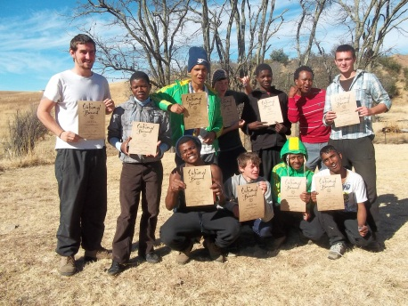
Learning from Girls & Boys Town
Definition:
Some of the social interactions described by participants suggest the transfer of skills from GBT into independent living.

Slide 15
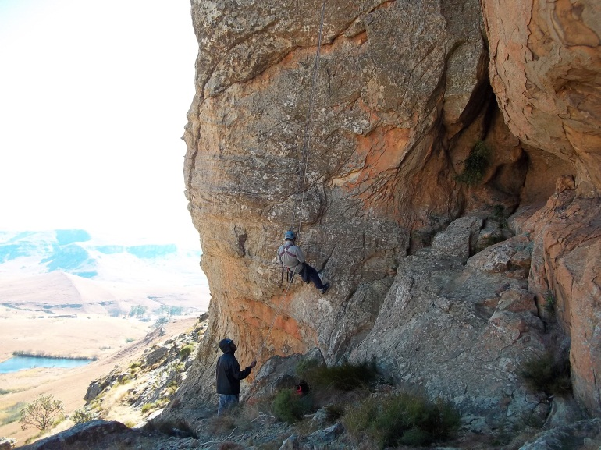
3 Stage research strategy
A retrospective study on narratives of ‘successing’ using grounded theory
Follow-up studies (MA, PhD)
A prospective, longitudinal, rolling cohort study on ‘successing’, from disengagement
Indicator development
A prospective, longitudinal
study on predictors of
success and ‘successing’

Slide 16
Thank you and contact details
LEE LOYNES:
ll@gbtown.org.za
Website: www.girlsandboystown.org.za
ADRIAN VAN BREDA:
avanbreda@uj.ac.za
website: www.adrian.vanbreda.org

