Slide 1
The Therapeutic Use of Daily Life Events
Thom Garfat, PhD
CYC-Net Clan Gathering Conference

Slide 2
Engaging in the Opportunities Available in the Moments of Daily Life

Slide 3
Founded on the Characteristics of a Child & Youth Care Approach
Participate with people as they live their lives Rituals of encounter Meeting them where they’re at Connection and engagement Being in relationship Examining context Intentionality of action Responsively developmental Hanging out Hanging in Needs-based focus Counseling on the go Doing ‘with’, not ‘for’ or ‘to’ | Working in the now Flexibility and individuality Rhythmicity Reflection Meaning-making Purposeful use of activities Family-oriented Being emotionally present Strengths based & resiliency focus It’s all about us Love Using daily life events to facilitate change
Garfat & Fulcher, 2011

Slide 4
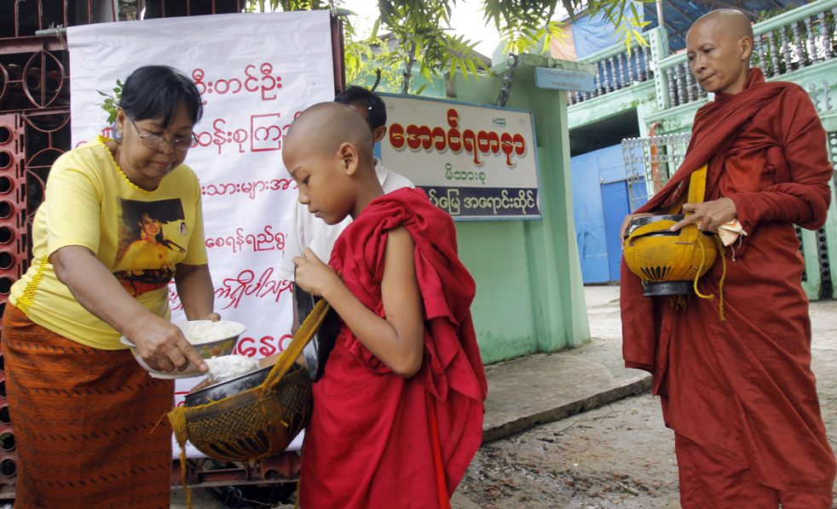
This is Not a New Idea – the Importance of Daily Life Events

Slide 5
REDL (1959)
“This opportunity gives (the worker)
a long-hoped-for chance to help the client.”
MAIER (1987)
“Genuine carework
entails the utilization of everyday happenings”
WARD (1998)
“Workers . . . have to ‘be therapeutic’ in everyday life alongside the children . . . in the informal ‘in-between times’ and at unplanned moments.”

Slide 6
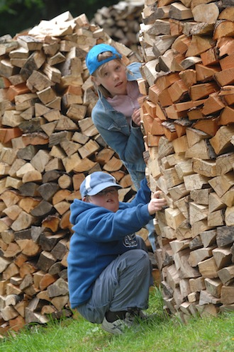
The Little Things
Focusing on small important moments and experiences is a part of the history of working with young people.

Slide 7
A FEW UNDERLYING PRINCIPLES
Notes:
What we are going to do now, is look at some of the basic underlying principles of this training and this approach.
Do not take too long to say this as it is just an intro to what follows.
But make sure you emphasize that these are foundational principles.
The following are worth a bit of time – they are important principles and so do not rush them – make sure people understand.

Slide 8
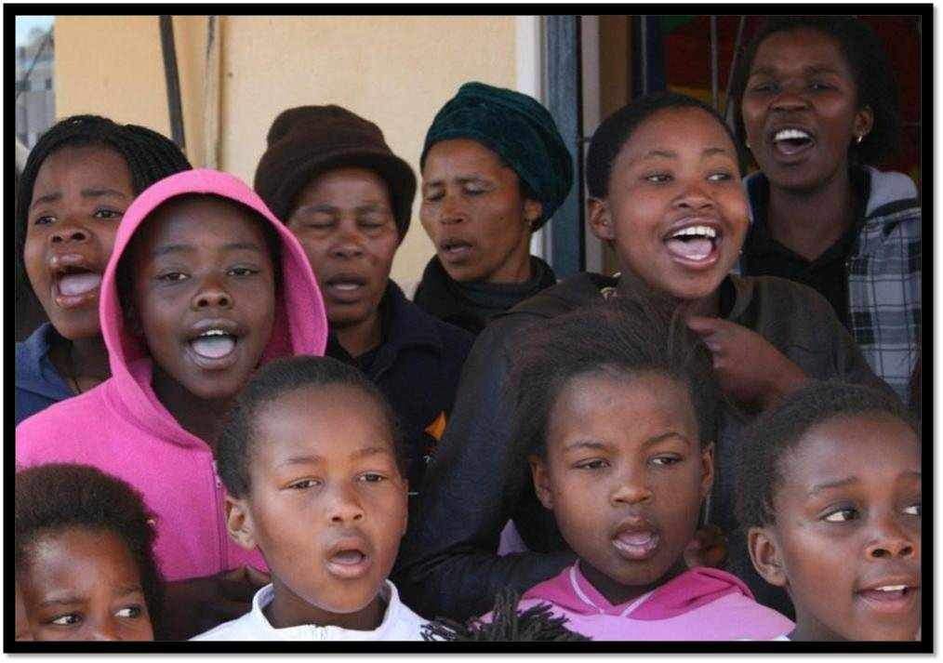
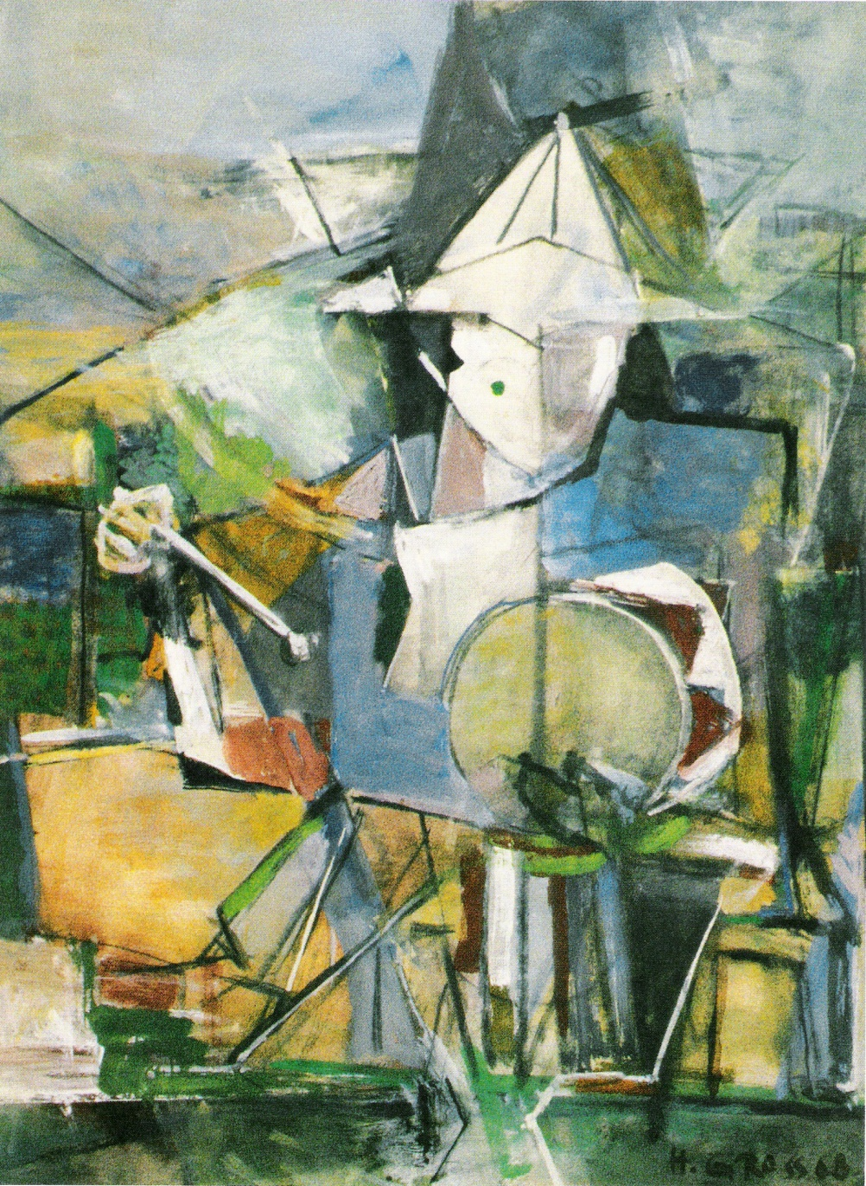
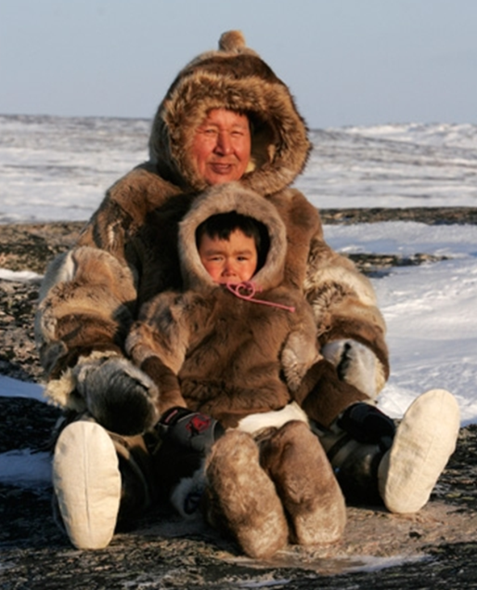
Everything Occurs in a Specific Context
Meaning Making is Central to Effective Intervention
Many youths could benefit from a different experience of self in relationship

Slide 9
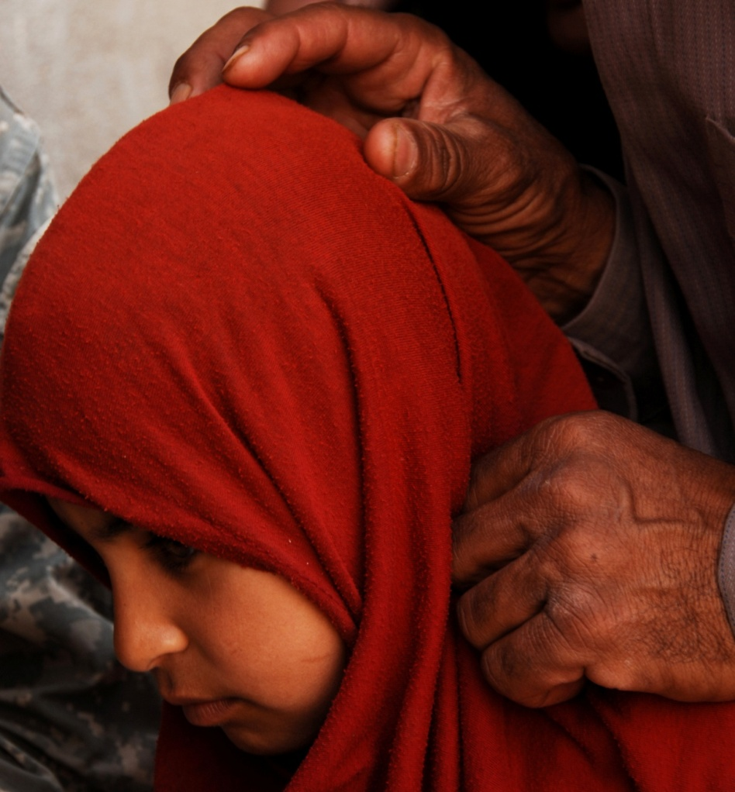
A Process for Intervening into Daily Life Events
Noticing
Analysis & Reflection
Preparation
Intervention

Slide 10
Noticing
‘Out there’ & ‘In here’
Attending to the moment
Do you see what I see?
Noticing opportunities
h

Slide 11
Noticing
Noticing ‘out there’
Context
Who does what
Rhythms
Connections
Opportunities
Noticing ‘in here’
Feelings
Thoughts
Physical experiences
Desires to act
Experience of Self in Context
(active self awareness)

Slide 12
Analysis & Reflection .
Analysis of behaviour as it relates to the Context of Intervention
Referencing theory or knowledge
Relating what you are seeing to your understanding of the youth
Defining the potential relationship of immediate to overall
Attending to Self (Meaning-Making in Action)

Slide 13
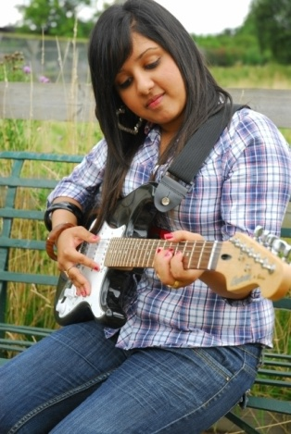
Intervention
Preparation of Self
Alternative Interventions
How might Other interpret the Intervention?
Timing
The Availability of Other

Slide 14
Intervention
Attending to Feedback
Approaching the Interaction
Connecting
Intention and Intervention

Slide 15
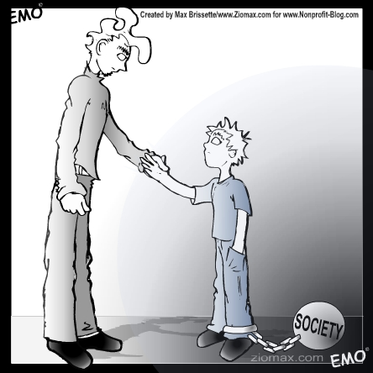
A Moment Can Change a Life Forever
But you changed my life Came along in a time of strife I was under the gun, clouds blocking the sun You changed my life
. . . Bob Dylan, 1982

