Slide 1
4 Million Hours of Care
A Canadian Story

Slide 2
Lesson One:
CYC work is all about positive competency- focused connections

Slide 3
Lesson Two:
CYC work is different than all other professions in that we do our practice in public and generally with other professional colleagues.

Slide 4
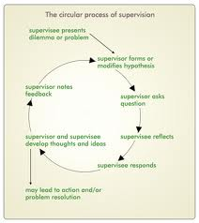
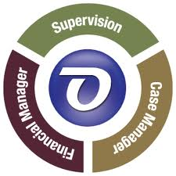
Lesson Three:
CYC’s need to have competent supervisory experiences

Slide 5
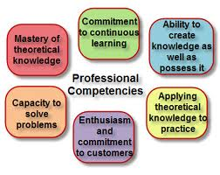
Lesson Four:
(the last lesson leads to the next) – our profession needs to attract and retain a wide variety of people that can provide direct service, can manage, can teach, can consult, can set policies and procedures, can conduct research, and can communicate.

Slide 6
Lesson Five:
Child & Youth Care needs to be promoted, supported, and articulated as a profession in the fullest sense.

Slide 7
Thank you

