Slide 1
…with the brain in mind.
CYC-net 2012

Slide 2
Our Journey

Slide 3
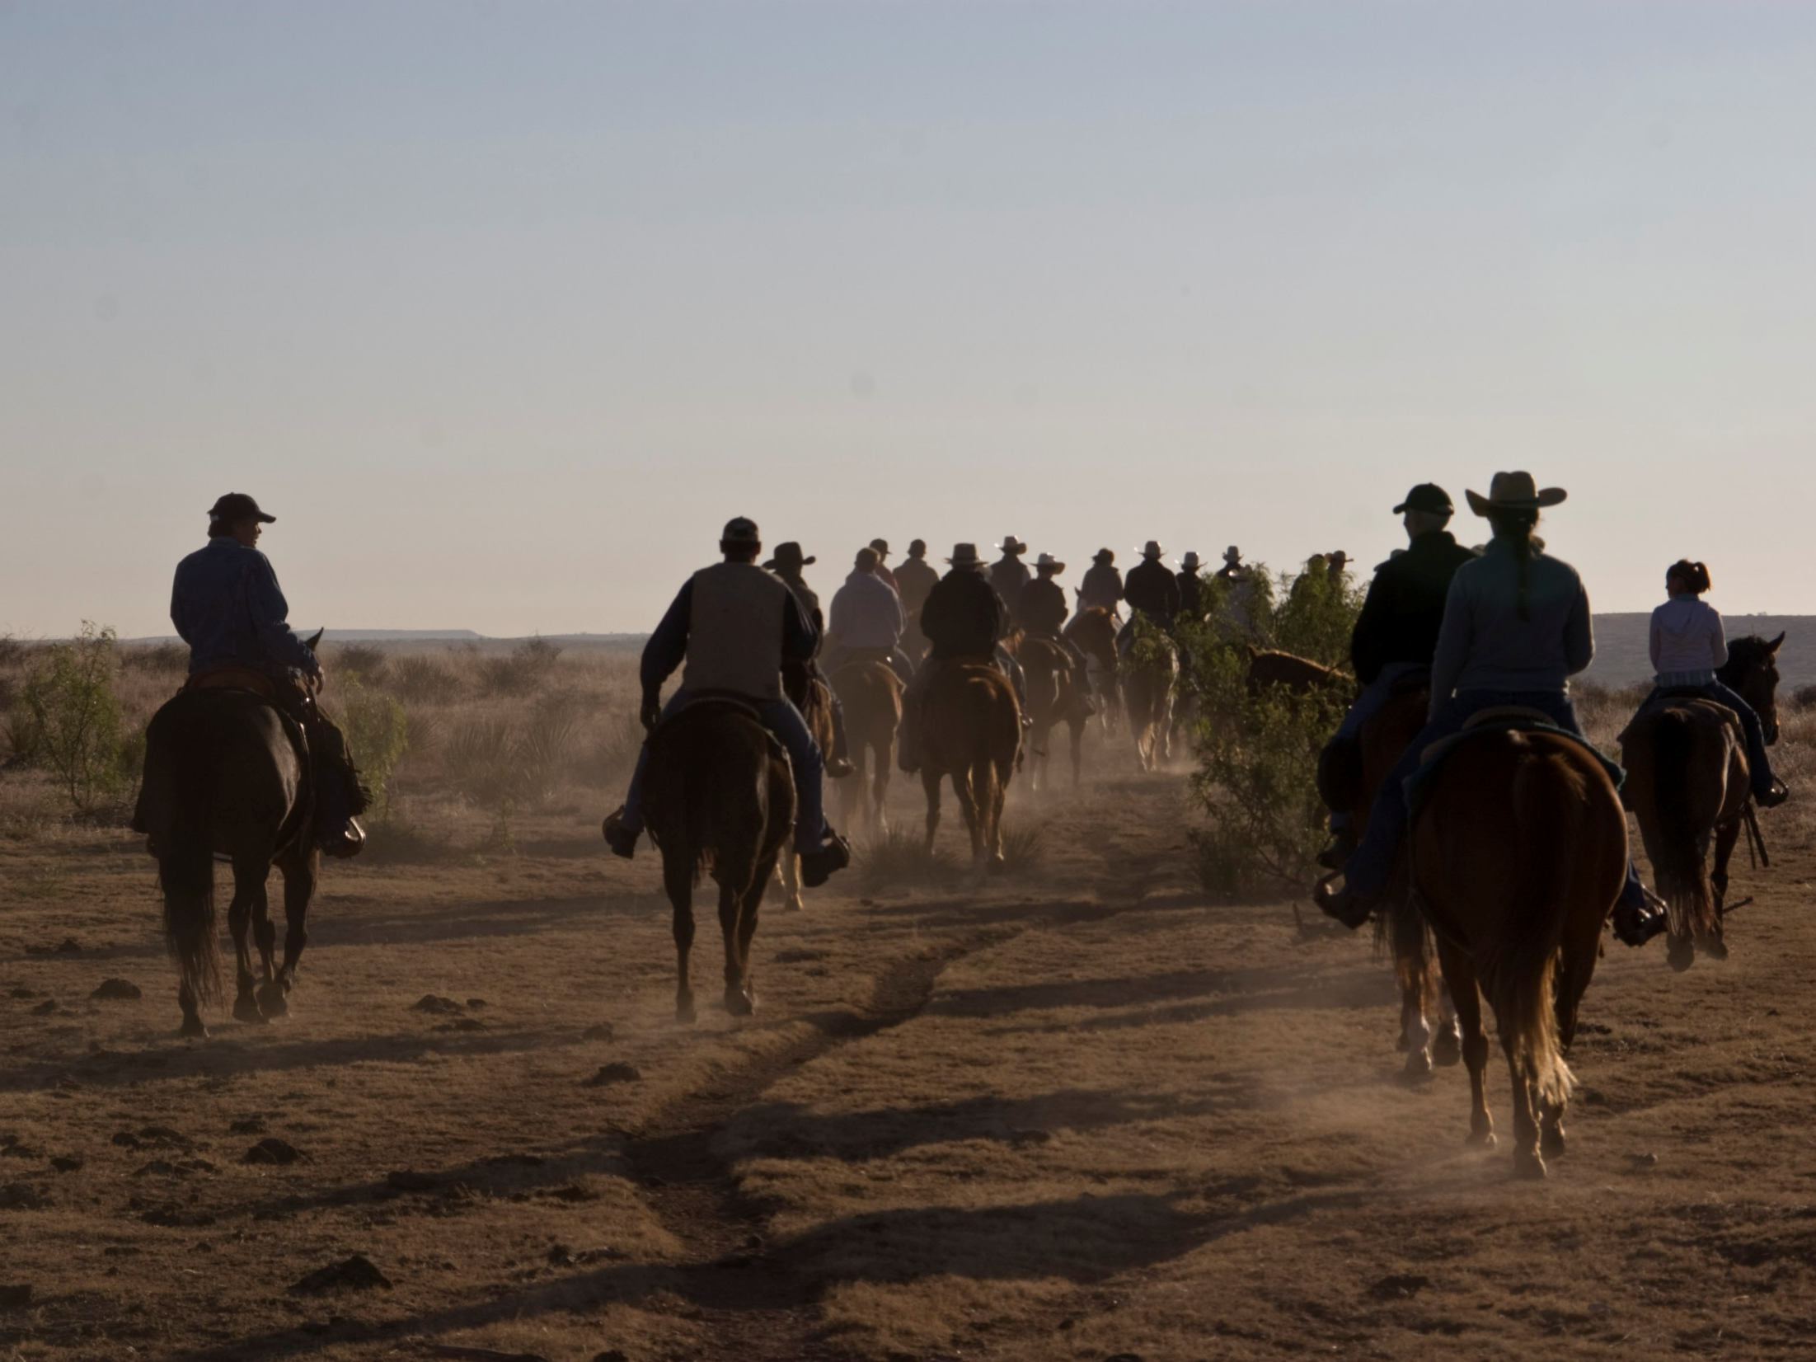

Slide 4
Summary
Census – Days in Care
  11% increase
  9297 added days in care
Staff Retention
  30% decrease in turnover
Campus Stability
  19% decrease in incidents
Quality / Success Rate
  8% increase
Cost
  9% reduction in cost per day in care

Slide 5
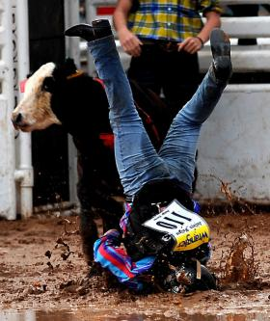

Slide 6
Model of Leadership & Service

Slide 7


Slide 8


Slide 9
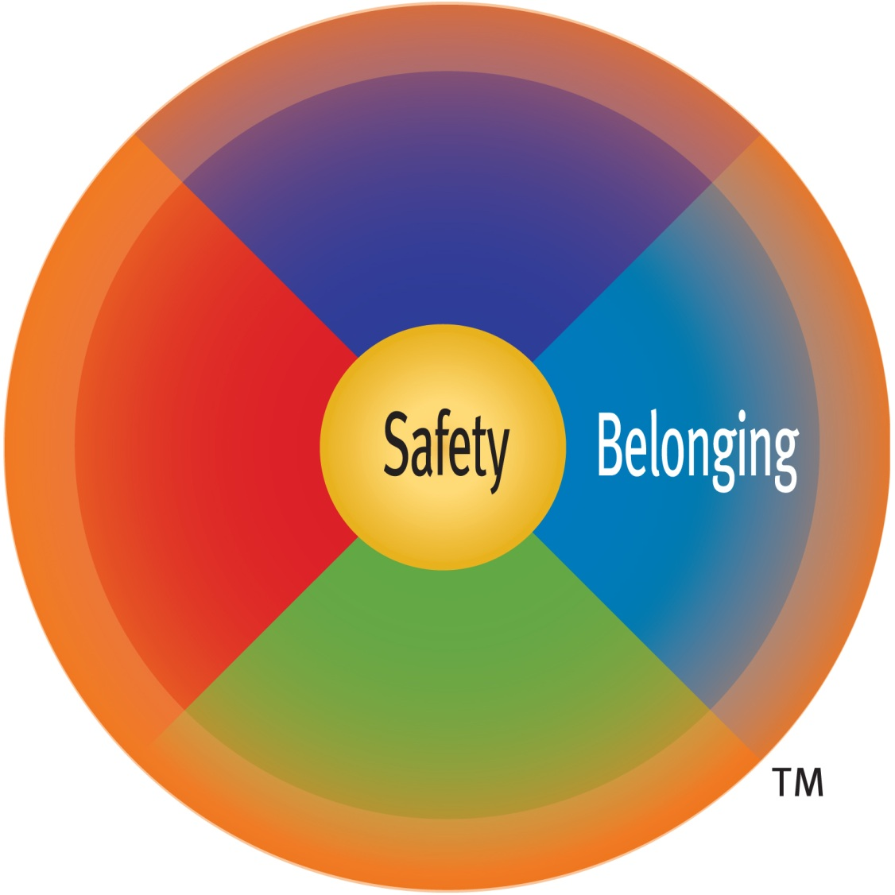

Slide 10
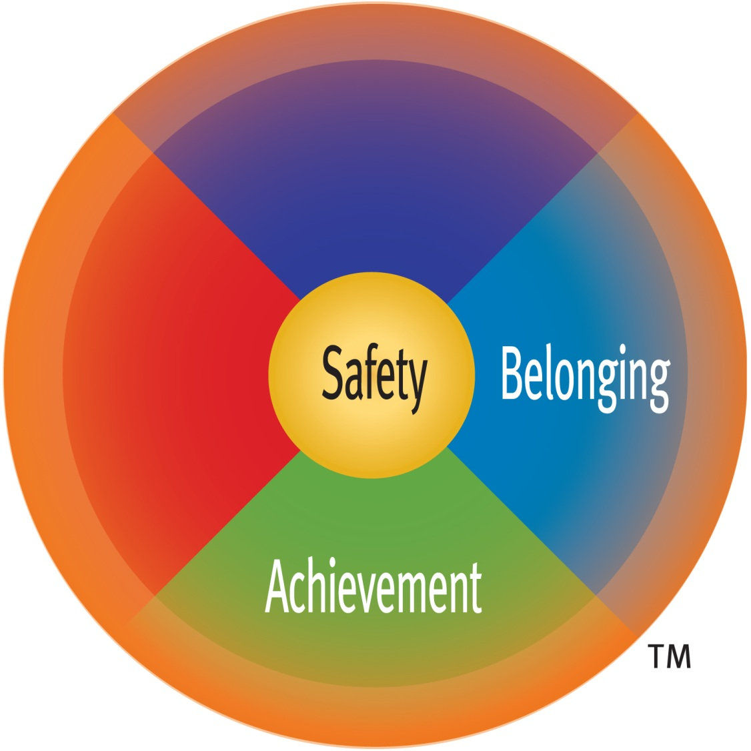

Slide 11
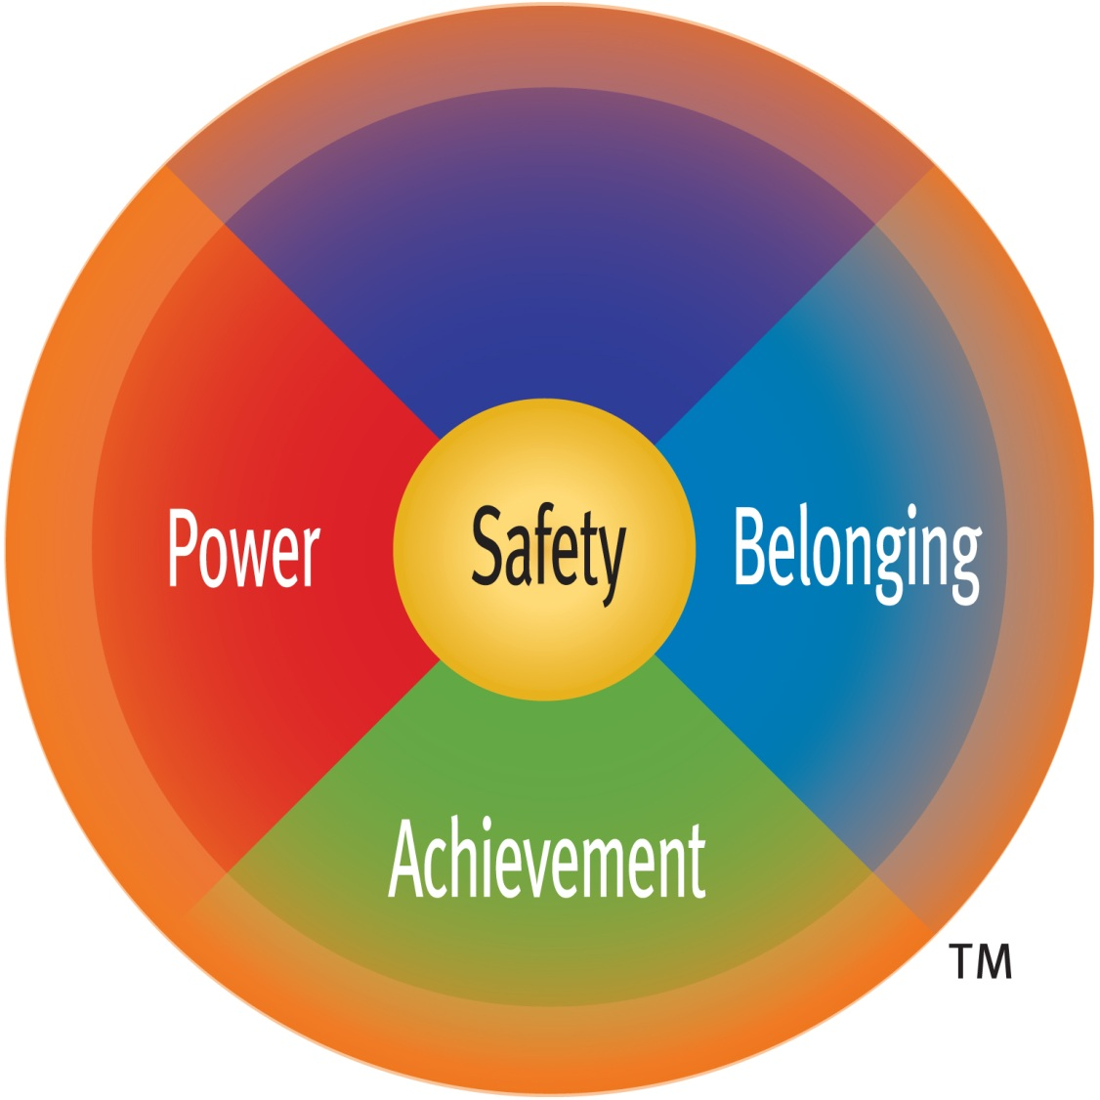

Slide 12
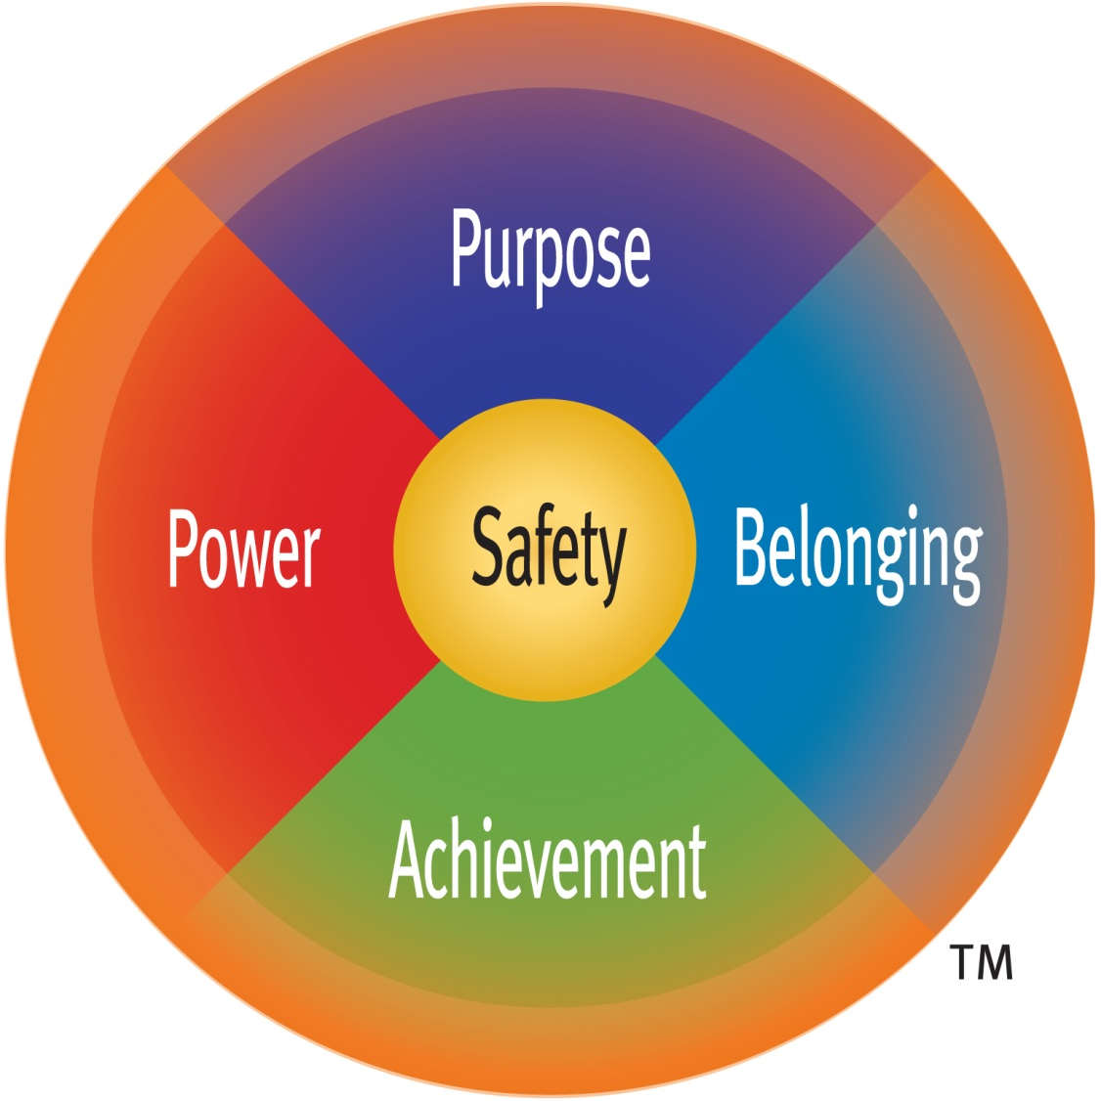

Slide 13
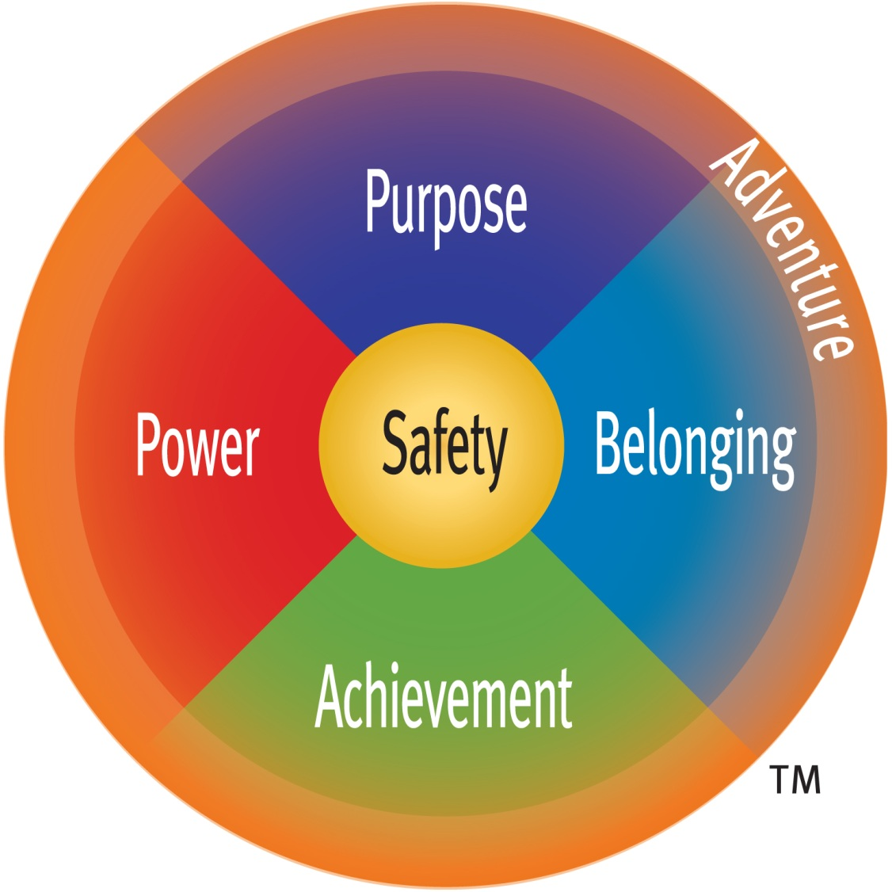

Slide 14


Slide 15
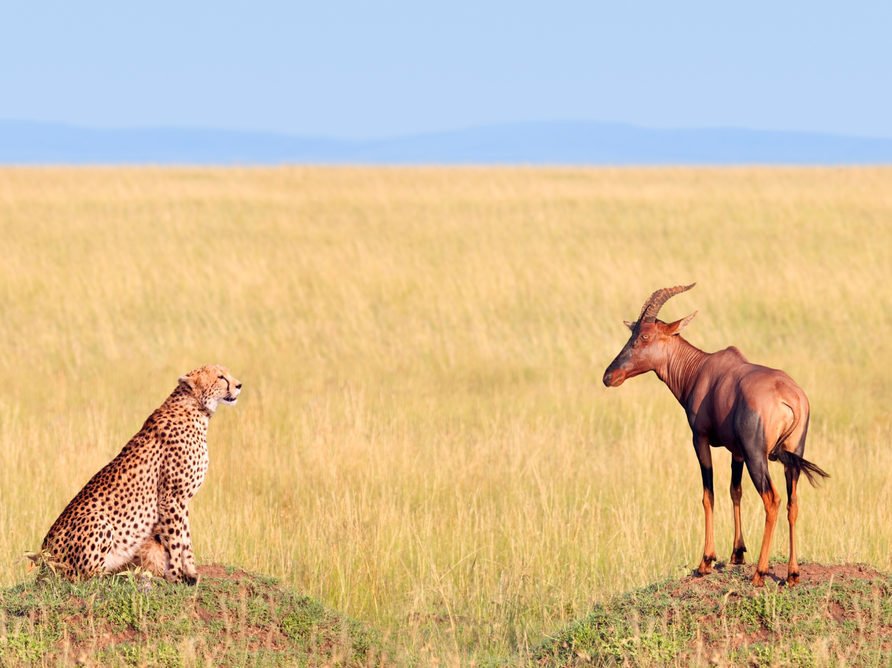

Slide 16
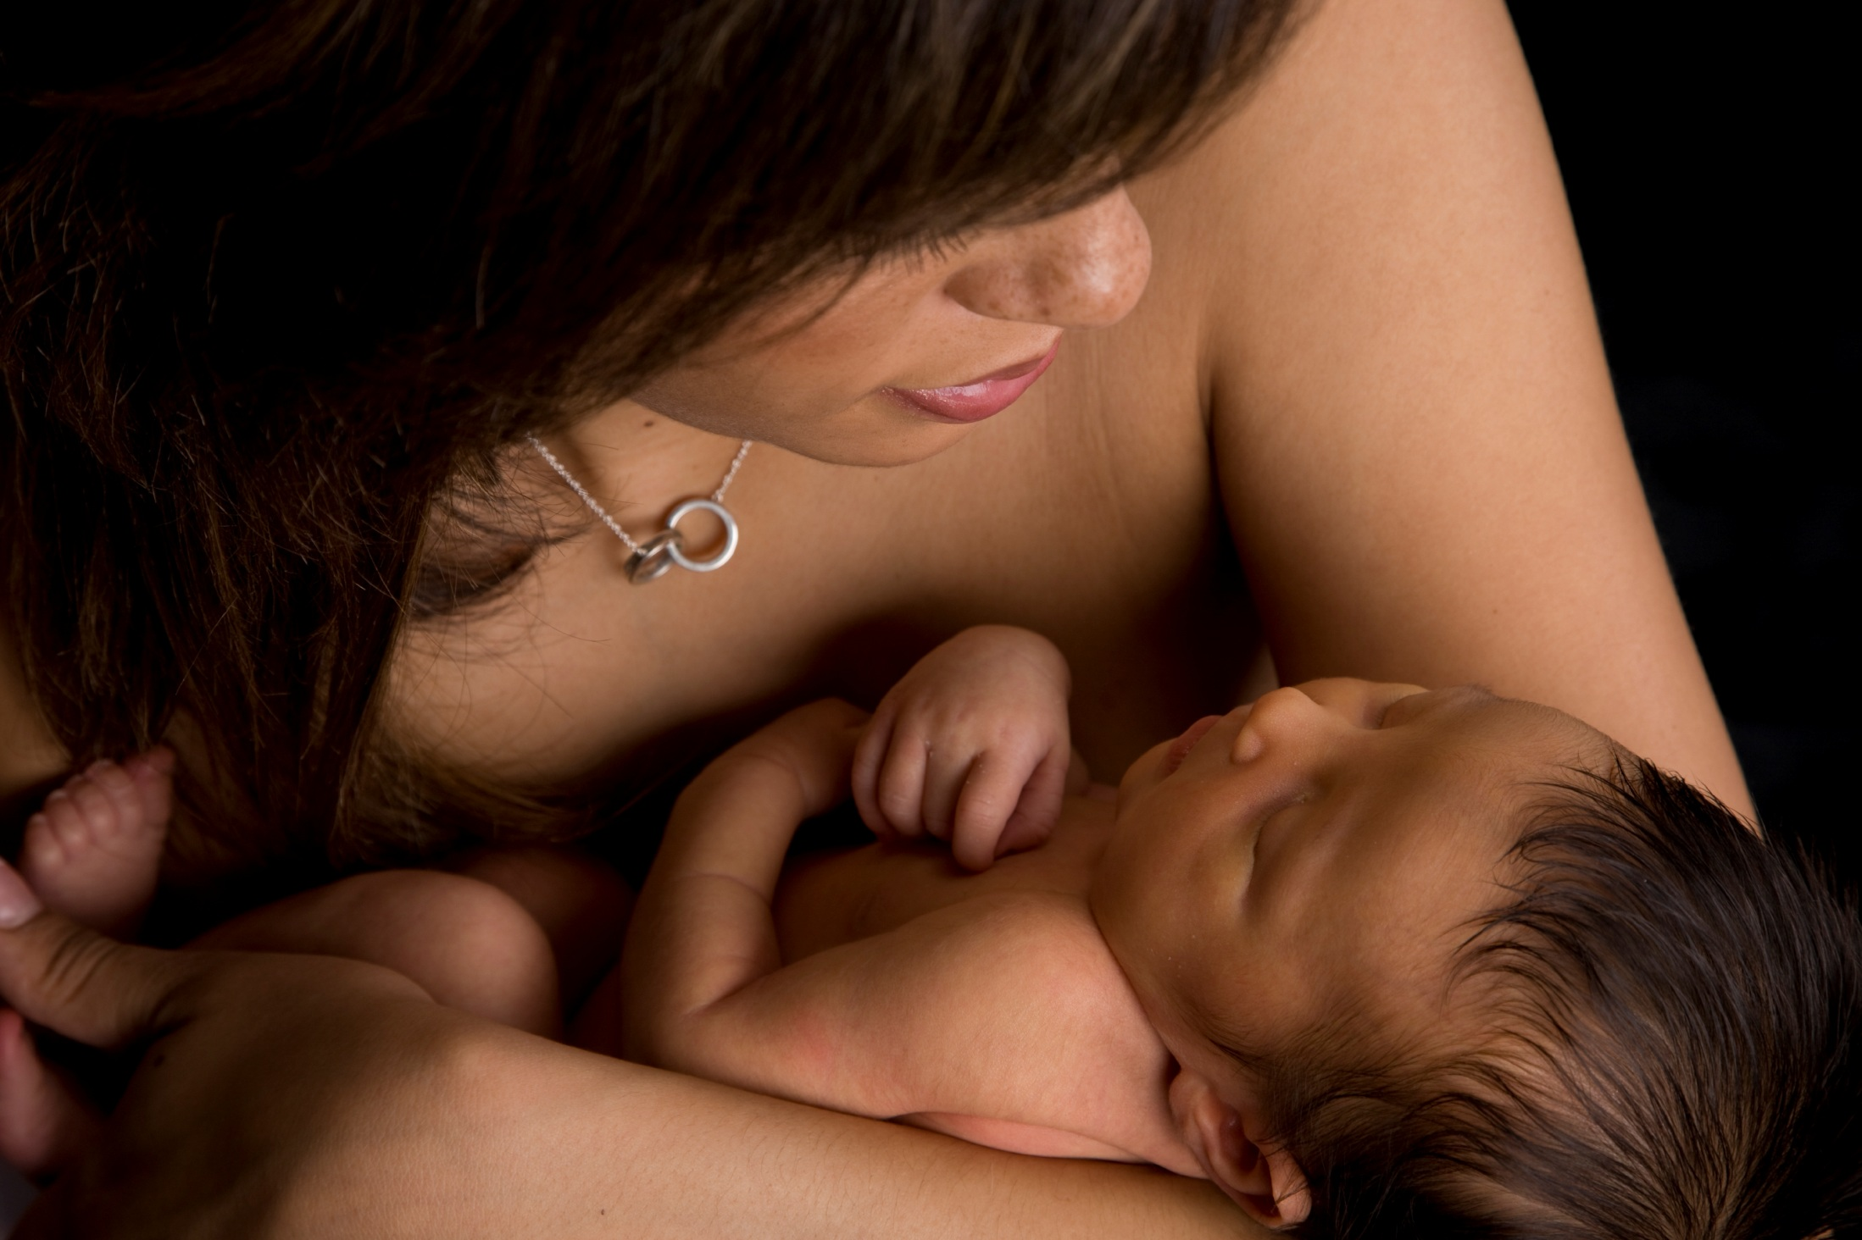

Slide 17
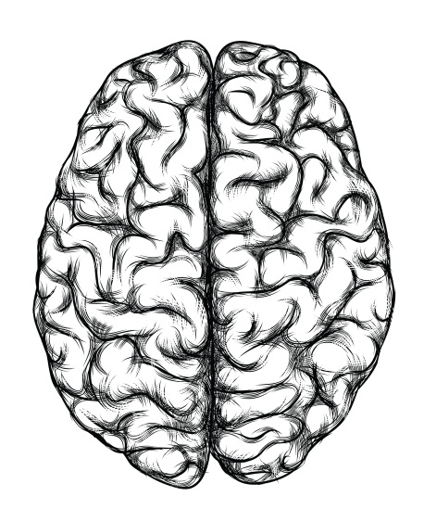

Slide 18
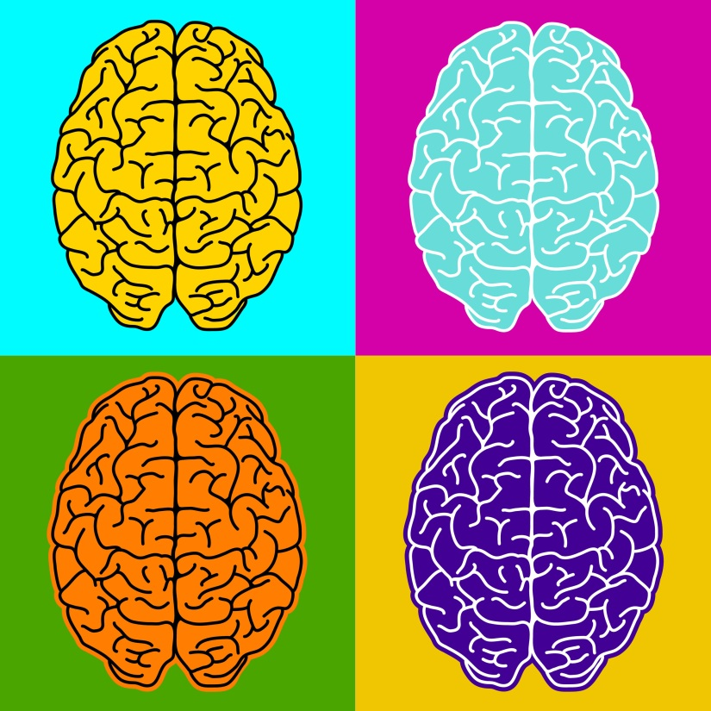

Slide 19
The McGurk Effect

Slide 20
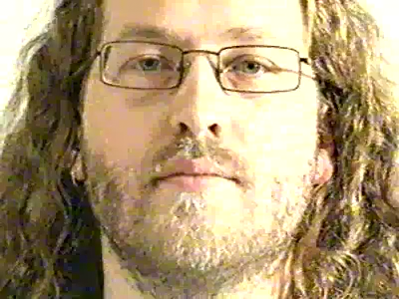
The McGurk Effect

Slide 21
The McGurk Effect

Slide 22
The McGurk Effect

Slide 23
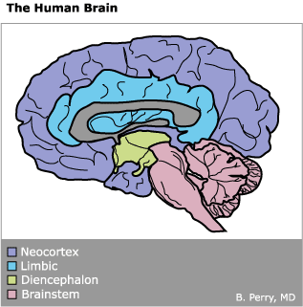
Hierarchy of the Brain
Neocortex
Limbic
Diencephalon
Brainstem

Slide 24
Hierarchy of the Brain
Abstract thought
Concrete Thought
Affiliation
“Attachment”
Sexual Behavior
Emotional Reactivity
Motor Regulation
“Arousal”
Appetite/Satiety
Sleep
Blood Pressure
Heart Rate
Body Temperature
Neocortex
Limbic
Diencephalon
Brainstem

Slide 25
Arousal Continuum
Notes:
graph of continuum
You are where? You have know where you are on the continuum
What about your audience? You have to know where the people in your audience are (do they need to be energized or calmed? Individual needs of each one
Curiosity and the absence of fear – use story to illustrate the importance of safety
Why does it matter when it comes to learning/teaching?
Trying to access the smart brain
Survival and social brains must be settled down first

Slide 26
Arousal Continuum
Terror
Fear
Alarm
Alert
Calm

Slide 27


Slide 28


Slide 29
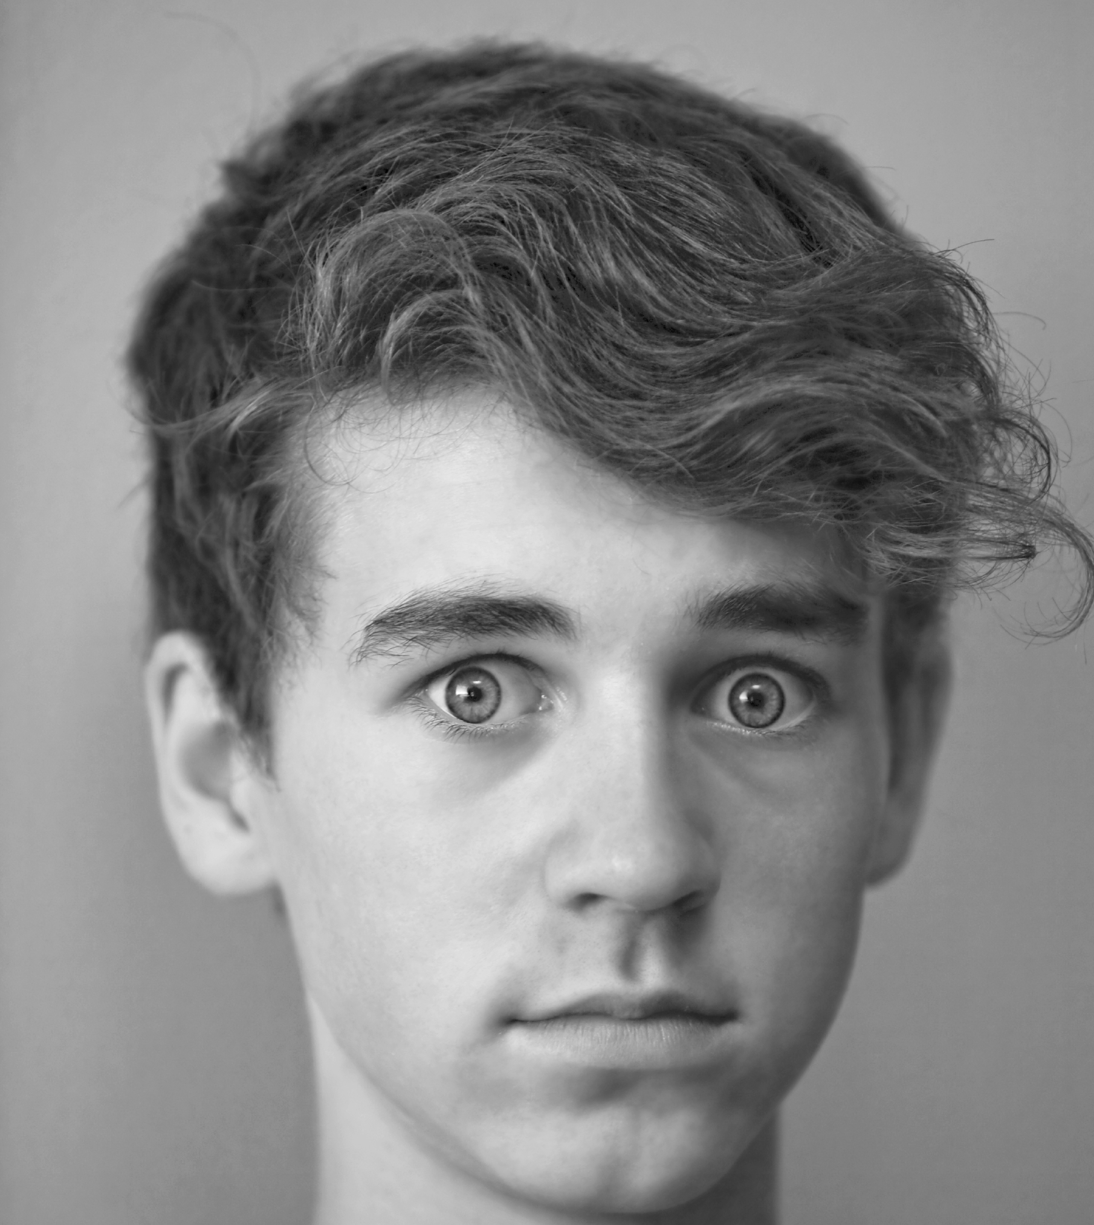

Slide 30


Slide 31
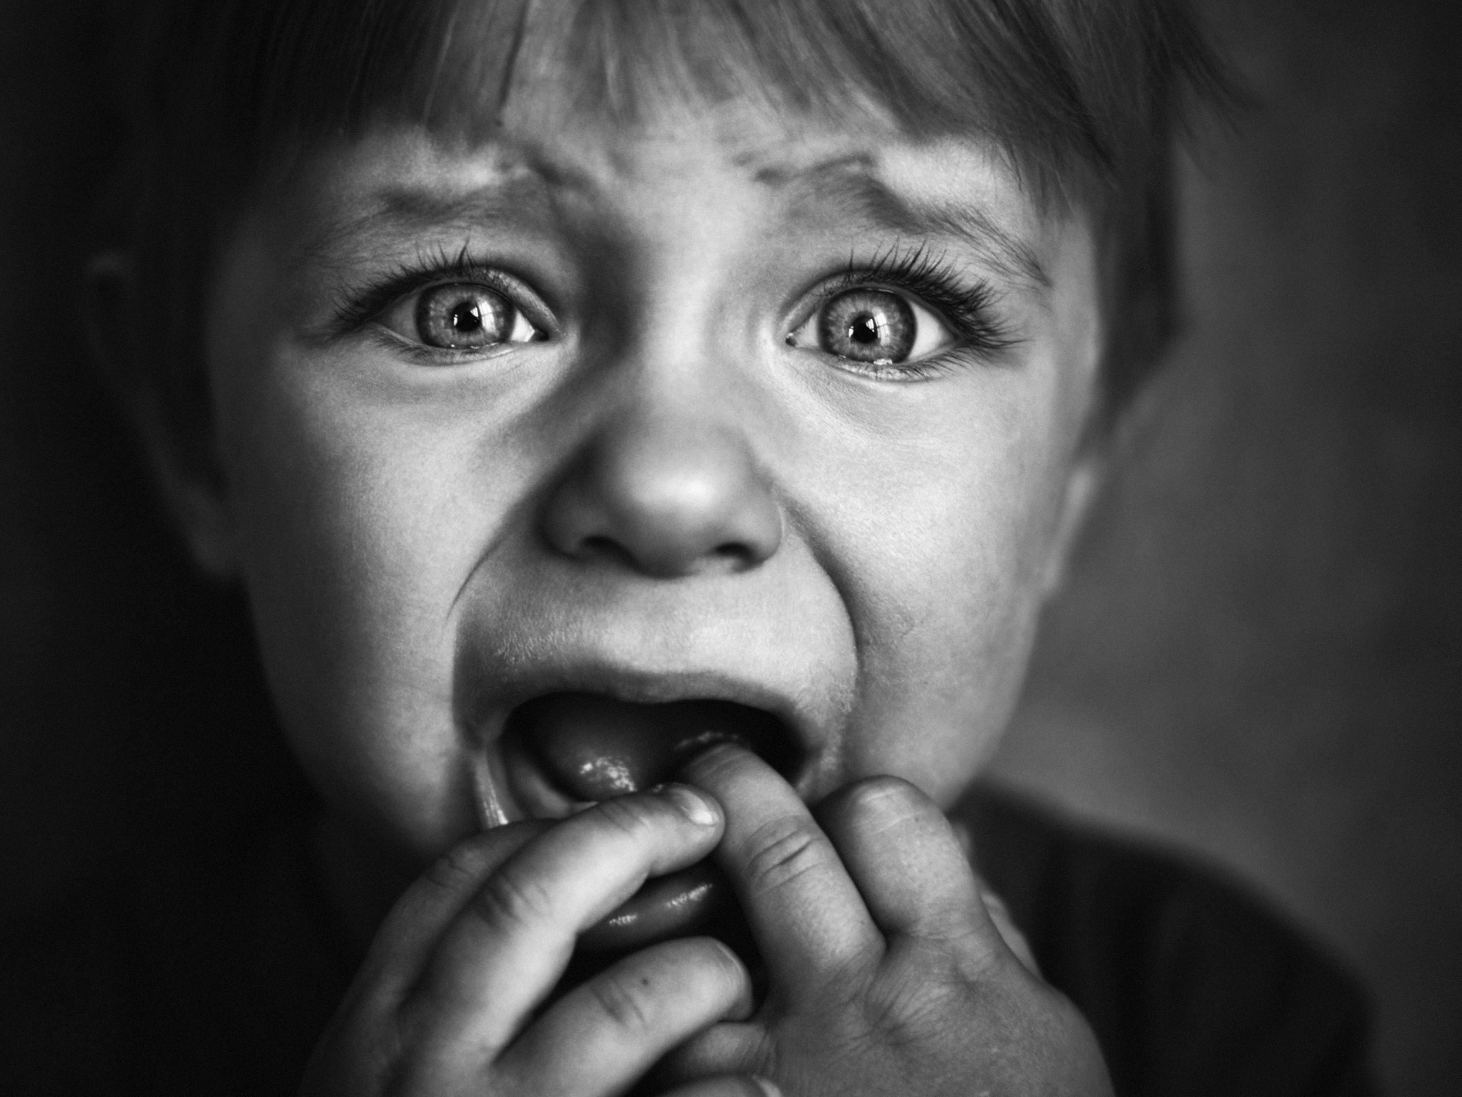

Slide 32


Slide 33


Slide 36


Slide 37
Why We Do What We Do – Deci (Harlow)
  Drive – Daniel Pink
First Break All The Rules – Q12 – Gallup/Marcus Buckingham
Primal Leadership – Daniel Goleman

Slide 38


Slide 39


